Slide 1
Project Types
Organic:
Routine project
Well understood domain
Team works well and efficiently together
Project expected to run smoothly
Typically a smaller system and smaller team
Embedded:
Difficulties expected
Project that is hard (control software for a nuclear plant, or spacecraft)
Team has little experience in domain
New or inexperienced team
Tend to be large projects with lots of constraints

Slide 2
Semidetached:
In the middle
Complex system, but something the company is familiar with
Teams may be made up of experienced and inexperienced members
System not huge, but not small either

Slide 3
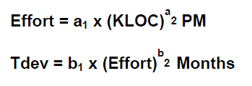
Basic COCOMO Model
COnstructive COst MOdel
The basic COCOMO model gives an approximate estimate of the project parameters.

Slide 4
person-months (PM).
The effort estimation is expressed in units of person-months (PM).
An effort of 100 PM does not imply that 100 persons should work for 1 month nor does it imply that 1 person should be employed for 100 months, but it denotes the area under the person-month curve .
It is the area under the person-month plot.

Slide 5
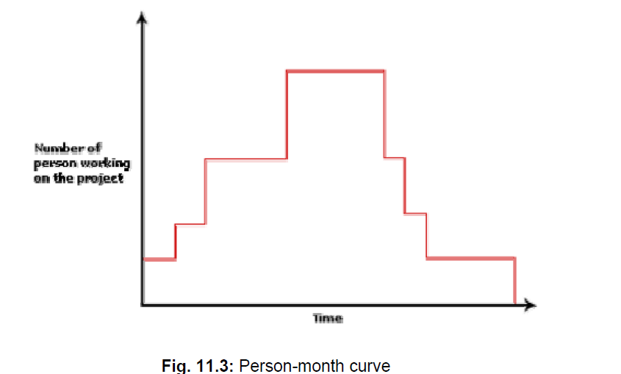
person-months (PM)

Slide 6
Intermediate COCOMO model
The basic COCOMO model assumes that effort and development time are functions of the product size alone.
However, a host of other project parameters besides the product size affect the effort required to develop the product as well as the development time.
Therefore, in order to obtain an accurate estimation of the effort and project duration, the effect of all relevant parameters must be taken into account.

Slide 7
15 Cost Drivers
Boehm requires the project manager to rate these 15 different parameters for a particular project on a scale of one to three.
Then, depending on these ratings, he suggests appropriate cost driver values which should be multiplied with the initial estimate obtained using the basic COCOMO.

Slide 8
Classification of Cost Drivers
Product: The characteristics of the product that are considered include the inherent complexity of the product, reliability requirements of the product, etc.
Computer: Characteristics of the computer that are considered include the execution speed required, storage space required etc.
Personnel: The attributes of development personnel that are considered include the experience level of personnel, programming capability, analysis capability, etc.
Development Environment: Development environment attributes capture the development facilities available to the developers. An important parameter that is considered is the sophistication of the automation (CASE) tools used for software development.

Slide 9
Formula for Effort
E = a1 (KLOC)^b1 x (EAF)
Where, E = Efforts applied in terms of person months (PM)
KLOC = Kilo lines of code for the project
EAF = Effort adjustment factor
The value of a1 and b1 for various classes of software projects are defined as:
Software Projects | a1 | b1
Organic | 3.2 | 1.05
Semi-detached | 3.0 | 1.12
Embedded | 2.8 | 1.20

Slide 10
Formula for Development time
D = b1 (Efforts) ^ b2
Values for b1 and b2:
Software Projects | b1 | b2
Organic | 2.5 | 0.38
Semi-detached | 2.5 | 0.35
Embedded | 2.5 | 0.32

Slide 11
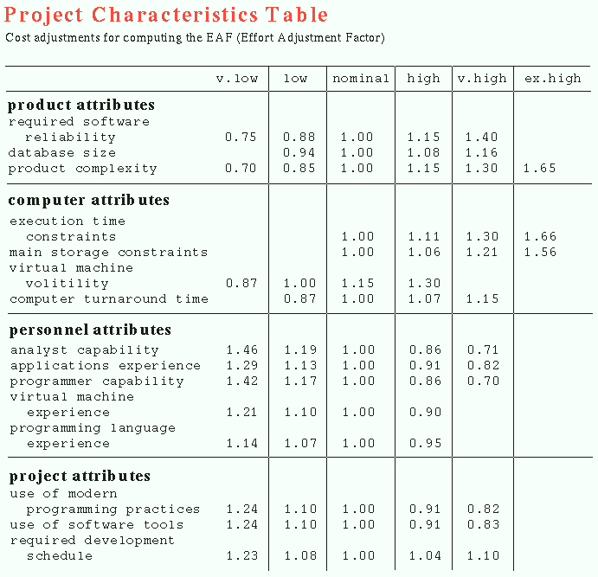

Slide 12
Q. Consider a project having 30,000 lines of code which in an embedded software with critical area hence reliability is high. Find out the estimation?

Slide 13
Solution:
Formula: E = a1 (KLOC)^b1 x (EAF)
The reliability is high, therefore EAF = 1.15
a1 = 2.8 ; b1 = 1.20 for embedded software
E = 2.8 (30) ^1.20 x 1.15 = 191 PM
D = b1(E)^b2
D = 2.5(191)^0.32 = 13 months approx

Slide 14
Q. Consider a project having 45,000 lines of code which in an
Organic software with parameters as:
low database size
nominal virtual machine volatility
High use of software tools
2. semi-detached software with parameters as:
reliability is high.
analyst capability is low.
Programming language experience is nominal
Find out the estimation?

Slide 15
Complete COCOMO model
A major shortcoming of both the basic and intermediate COCOMO models is that they consider a software product as a single homogeneous entity.
However, most large systems are made up several smaller sub-systems.
These subsystems may have widely different characteristics.
For example, some subsystems may be considered as organic type, some semidetached, and some embedded.

Slide 16
Example
A distributed Management Information System (MIS) product for an organization having offices at several places across the country can have the following sub-components:
• Database part
• Graphical User Interface (GUI) part
• Communication part
Of these, the communication part can be considered as embedded software.
The database part could be semi-detached software, and the GUI part organic software.
The cost of these components can be estimated separately and summed up to give the overall cost of the system.

Slide 17
Complete COCOMO (contd)
In other words, the cost of development of each sub-system is estimated separately, and the complete system cost is determined as the subsystem costs.
This approach reduces the margin of error in the final estimate.

Slide 18
The model that assumes that effort and development time are functions of product size alone is
(A) Basic COCOMO model
(B) Intermediate COCOMO model
(C) Detailed COCOMO model
(D) All the three COCOMO models

